Slide 1
ENGR 12
Dr. Mandala
Notes:
Down

Slide 2
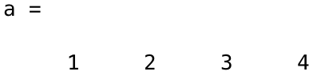
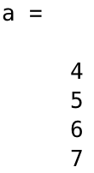
A little bit more about arrays
You can create a 1-dimensional array of any number of elements
You can only create a 2-dimensional array containing same number of elements in each row

Slide 3

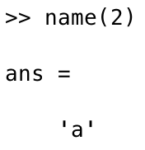
Strings
In MATLAB, strings are stored as a character array

Slide 4
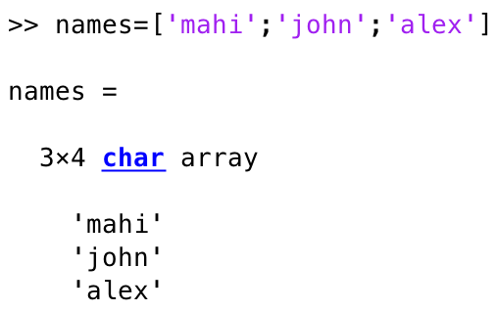
STRINGS
You can create a 2-dimension character array
Every row should contain same number of columns (characters)

Slide 5
String concatenation
There are various ways to concatenate string variables. For example, you can concatenate strings using the strcat command:
>> s=‘wonder’; w=‘fully’;
>> strcat(s,w) %answer is: wonderfully
Note that strcat removes trailing ASCII white-space characters. To preserve trailing spaces, you can use horizontal array concatenation:
>> s=‘Hello ’; w=‘World!’; %note the space after Hello
>> [s,w] %answer is: Hello World!
You can also combine a string and a number by converting the number to a string (using num2str command):
>> s=‘The final result is: ’; n=25;
>> [s,num2str(n)] %answer is: The final result is: 25

Slide 6
Matrix concatenation
Let A=[1 2;3 4] and B=[5 6;7 8]. To concatenate A and B, to obtain a new 4x2 matrix, you can use the following commands:
>> C=[A;B]; %direct approach; note use of semicolon
>> C=cat(1,A,B); %using cat command
>> C=vertcat(A,B); %using vertcat command
To concatenate A and B, to obtain a new 2x4 matrix, you can use the following commands:
>> D=[A,B]; %direct approach; note absence of semicolon
>> D=cat(2,A,B); %using cat command
>> D=horzcat(A,B); %using horzcat command

Slide 7
Entering external data
saving workspace variables
To save workspace variables/data (note that when MATLAB is exited, all workspace variables are automatically cleared), use the save command. This command saves the data in a compressed binary file with a .mat extension (called a MAT-file)
example
Assume that the variables z (=2) and y (=‘hello’) are already residing in the workspace. Then
>> save myVar.mat %saves z and y to a file names myVar.mat
>> save myVar.mat z %only saves z to myVar.mat

Slide 8
Entering external data
loading data
To load external data (either a .mat file or .dat file) into MATLAB, use the load command. This command restores data from a file into the workspace
example
Assume that you have access to two files called myData.mat and Data.dat. Then,
>> load myData.mat %loads data stored in myData.mat
>> load Data.dat %loads data stored in Data.dat
loading and assigning data to a variable
>> d=load(‘Data.dat’); %loads and assign content to variable d

Slide 9
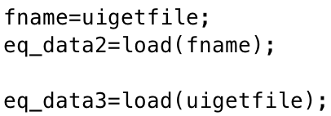
Loading data with interaction
Ask the user for the file name using input, and use it to load data
Note: ‘s’ at the end forces the data extracted to be of string data type—see next slide
Use the uigetfile command to the let the user browse for the file on their computer system

Slide 10
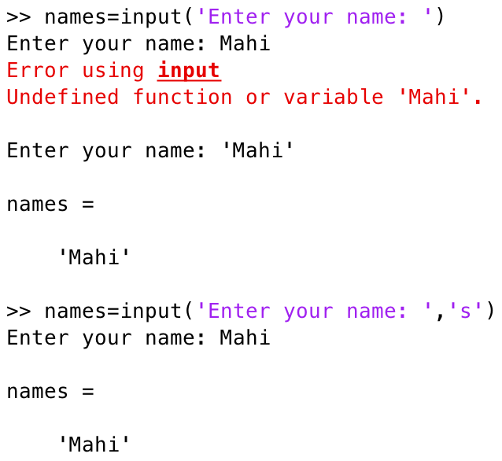
Input command
MATLAB assumes user entry for input command is a number, function, or variable.
To successfully enter text, we need to enclose it within single quotes ‘ ’
However, if you add ‘s’ at the end of the argument in input command, MATLAB expects a string, and throws no tantrums!

Slide 11
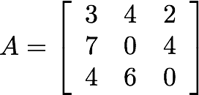
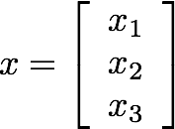
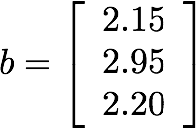
Simultaneous linear eqn
Collect the unknowns: cost of tangerine (x1), banana (x2), and peach (x3) into a vector x; collect coefficients of x into a matrix A; collect right hand side numbers into a vector b; this will result in an equation of the form…
3 | x1 | + | 4 | x2 | + | 2 | x3 | = | 2.15
7 | x1 | + | 0 | x2 | + | 4 | x3 | = | 2.95
4 | x1 | + | 6 | x2 | + | 0 | x3 | = | 2.20

Slide 12

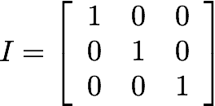

To find the unknowns, i.e., component in vector x, left multiply this equation by the inverse of matrix A
identity matrix
inverse of matrix A
Therefore, the unknowns are found by multiplying the inverse of matrix A (if it exists) by vector b
SOLUTION

Slide 13
In matlab
To solve Ax=b in MATLAB, you need to first check if the inverse of matrix A exists, and if it does, then compute the inverse of matrix A and multiply it by vector b, i.e., inv(A)*b
DETERMINANT
To check if the inverse of A exists, use MATLAB’s det command
INVERSE
To compute the inverse of matrix A, use MATLAB’s inv command
ALTERNATIVE METHOD
Since A is a matrix and b a vector, then you can use the left matrix divide operator (see Using MATLAB as a calculator) to solve Ax=b, i.e., A\b (note that you still need to check if the determinant of A exists)

Slide 14
Sample code
example
Let A=[3 4 2;7 0 4;4 6 0] and b=[2.15;2.95;2.20].
>> det(A) %returns 76, which means that it exists
>> x=inv(A)*b %returns x=[0.25;0.20;0.30]
Alternatively
>> x=A\b %returns x=[0.25;0.20;0.30]

Slide 15
Relational & Logical Operators
relational operators
Logical operators
operator | SYNTAX
Equal | ==
Not equal | ~=
Greater than | >
Less than | <
Greater or equal | >=
Less or equal | <=
operator | SYNTAX
And | & (element-wise) && (short-circuit)
Or | | (element-wise) || (short-circuit)
Not | ~
XOR | xor
All true | all
Any true | any
Note: Boolean values: 0 is false; nonzero is true
For a detailed list of operators see: help .

Slide 16
Conditional statements
if-Else
structure
If
Structure
if-Elseif-else
structure
if (condition)
command(s)
end
if (condition)
command(s)
else
command(s)
end
if (condition)
command(s)
elseif (condition)
command(s)
.
.
.
else
command(s)
end
Note: Conditional statement within the parentheses will evaluate to 0 (false) or 1 (true)
Source: MIT OpenCourseWare (http://ocw.mit.edu)

Slide 17
Conditional statements
Let a=14.2, b=12.3.
example 1 - if statement
if (a > b) %check if a is greater than b
c=‘a is greater than b’; %create new variable
end
example 2 - if-else statement
if (a > b) %check if a is greater than b
c=‘a is greater than b’; %create new variable
else %if a is not greater than b, then
c=‘a is less than b’; %create new variable
end
example 2 - if-elseif-else statement
if (a > b) %check if a is greater than b
c=‘a is greater than b’; %create new variable
elseif (a < b) %if a is not greater than b, then
c=‘a is less than b’; %create new variable
else
c=‘a and b are equal’; %create new variable
end

Slide 18
Loops: for
for-loops are used for a known number of iterations
loop variable
Defined as a vector, e.g., ii=1:10
Scalar within the command block
Does not have to have consecutive values (though, it’s usually cleaner if they’re consecutive)
for-loop
Structure
for (loop-variable)
command(s)
end
Source: MIT OpenCourseWare (http://ocw.mit.edu)

Slide 19
Loops: for
example
Let a=[1 2 3 4] and b=[5 6 7 8]. Swap values of a and b.
c=a; %make a copy of vector a
for ii=1:length(a) %need to loop 4 times
a(ii)=b(ii); %at each iteration, swap numbers
b(ii)=c(ii); %at each iteration, swap numbers
end

Slide 20
Loops: while
while-loop is like a more general for-loop; do not need to know number of iterations
The command block will execute while the conditional expression, i.e., (condition), is true
Beware of infinite loops!
while-loop
Structure
while (condition)
command(s)
end
Source: MIT OpenCourseWare (http://ocw.mit.edu)

Slide 21
Loops: while
example
Let a=[1 2 3 4] and b=[5 6 7 8]. Swap values of a and b.
c=a; %make a copy of vector a
ii=1; %define a variable to count
while(ii<=4) %need to continuously check a condition
a(ii)=b(ii); %at each iteration, swap numbers
b(ii)=c(ii); %at each iteration, swap numbers
ii=ii+1; %increment counter
end

Slide 22
Checking for errors
Syntax error
MATLAB will let you know
Logical error
You will notice incorrect output or weird results
Data error or other USER-Entered error
MATLAB may show the error
You can check for and display the errors to the user

Slide 23
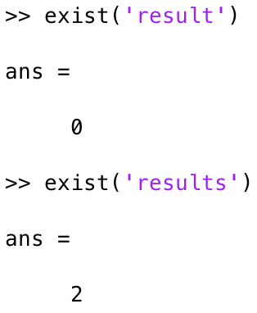
Checking for user input errors
Incorrect file name
Use command exist(filename)
Command will return true (non-zero) or false (0)

Slide 24

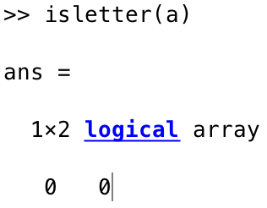
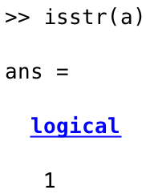
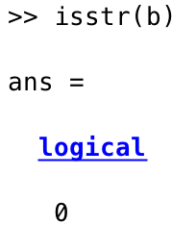
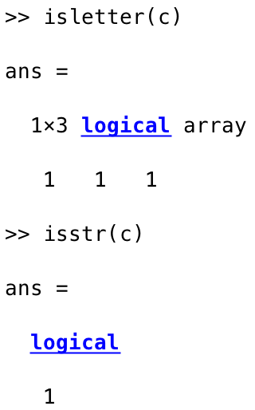
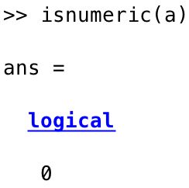
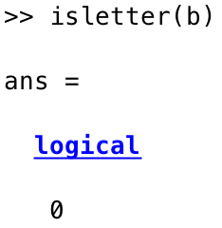
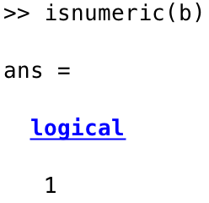
Checking for user input errors
Incorrect data type entered
Use command isletter(variable) or isnumeric(variable) or isstr(variable) or isstring(variable)
Command will return true (non-zero) or false (0) depending on whether the data entered matches the type
Notes:
Isnumeric checks for data type and whether this is a numeric array or not.
Isletter checks for whether the array of string or number contains a letter or not
Example: a=’12’
isnumeric(a) will return false
Isletter(a) will also return false, since both 1 and 2 are not letters.

Slide 25
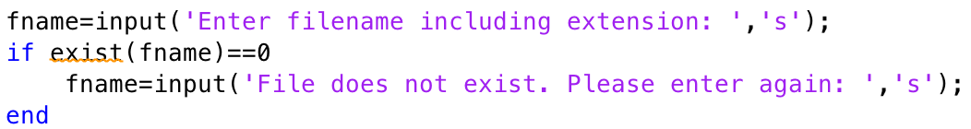
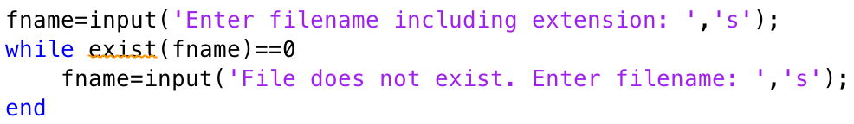
Checking for errors – SAMPLE CoDE

Slide 26
Acknowledgment
Based on handouts and lectures by Dr. Arash Mehboobin

